Slide 1
COVID-19 cases and impact at a glance

Slide 2
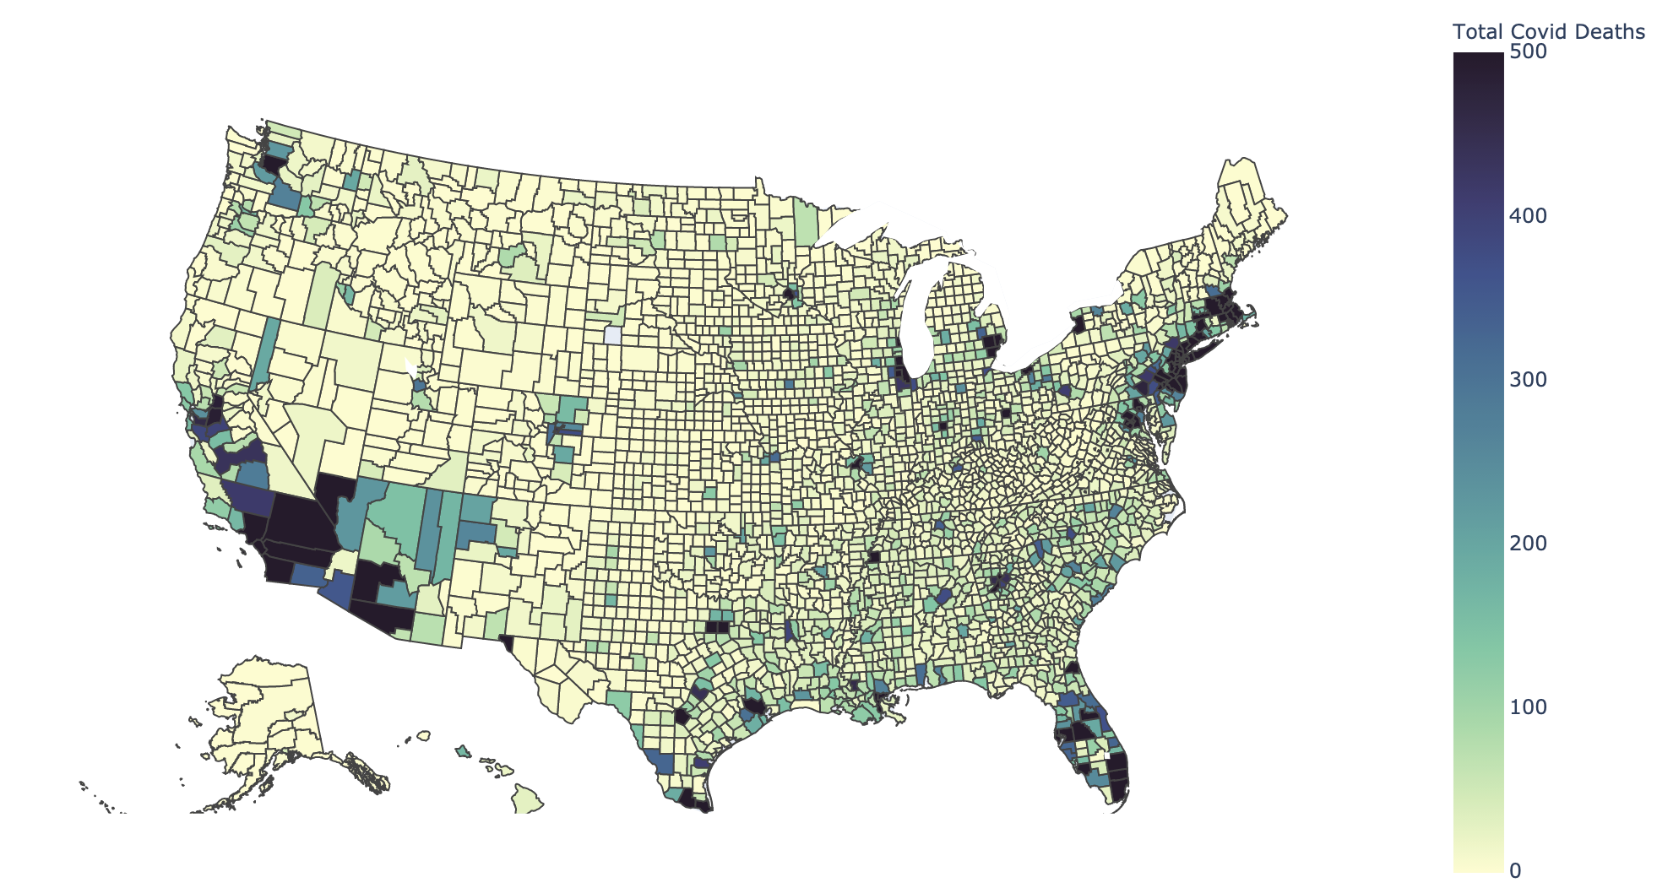
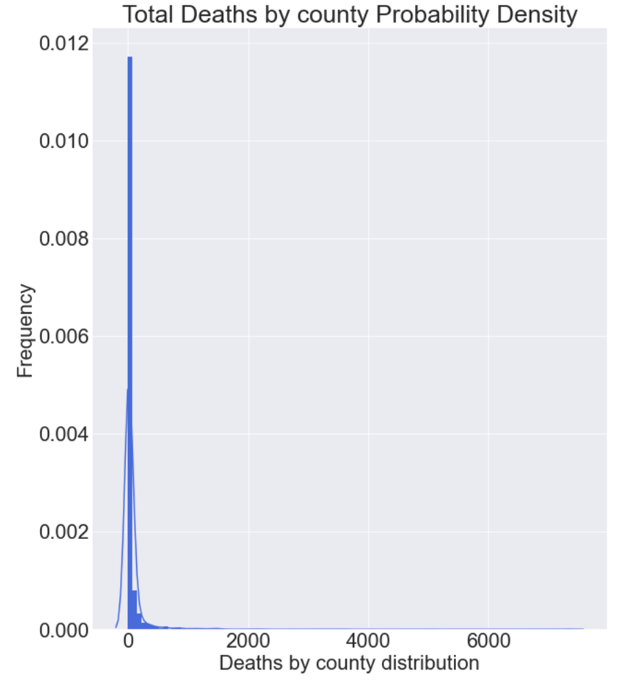
Covid Deaths by county distribution is extremely right skewed. Top 10 counties (LA, NYC, Miami, etc.) accounted for 21% of all death cases.
USA Facts COVID 19 Deaths. Jan. - Oct. 2020
Notes:
Total Covid Deaths across US, by county

Slide 3
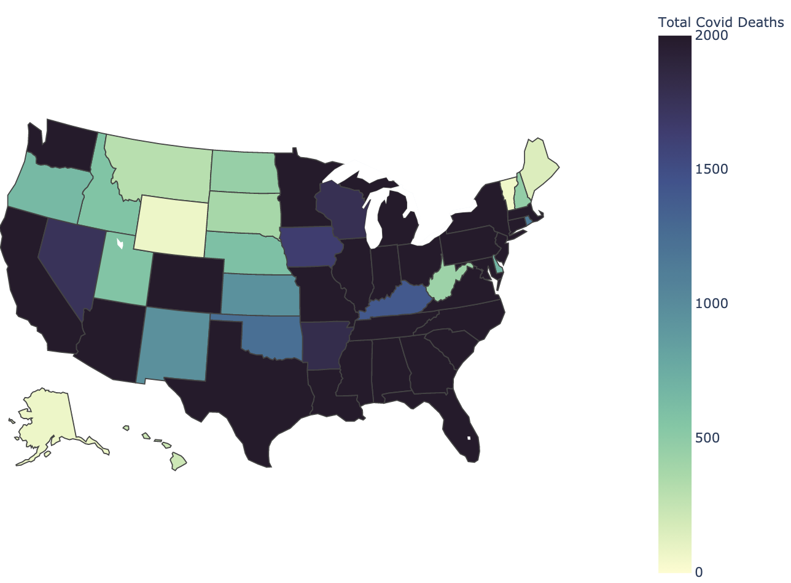
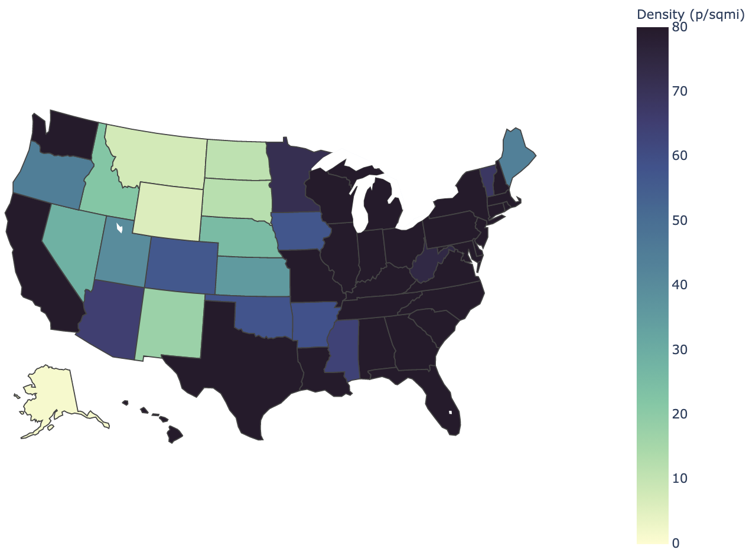
Covid Deaths by state and Population Density by state heatmap resembles each other.
USA Facts COVID 19 Deaths. Jan. - Oct. 2020

Slide 4
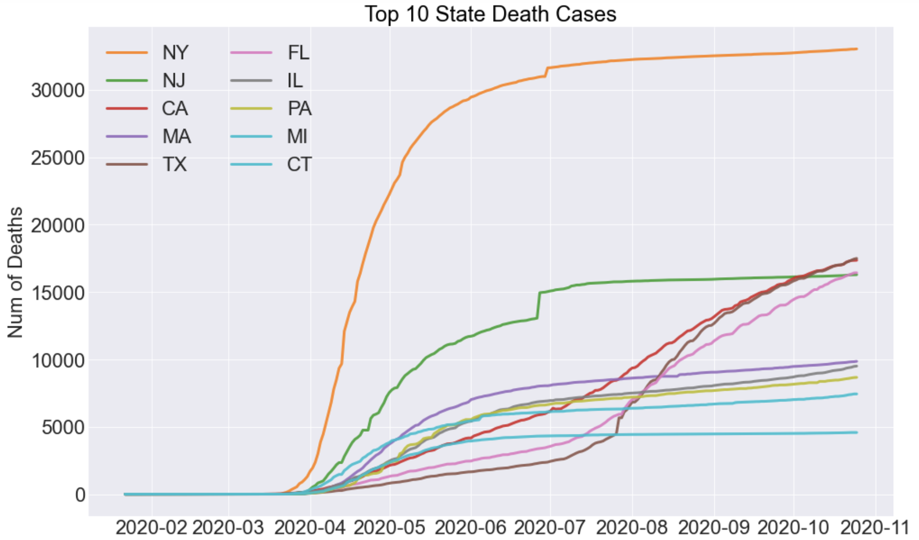
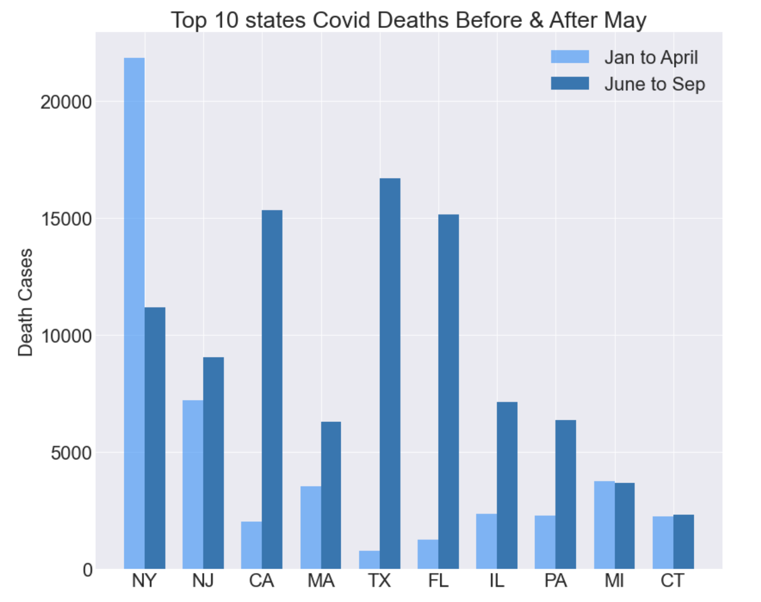
States including CA, TX, FL failed to “flatten the curve” after reopening.
Reopening period
USA Facts COVID 19 Deaths. Jan. - Oct. 2020

Slide 5
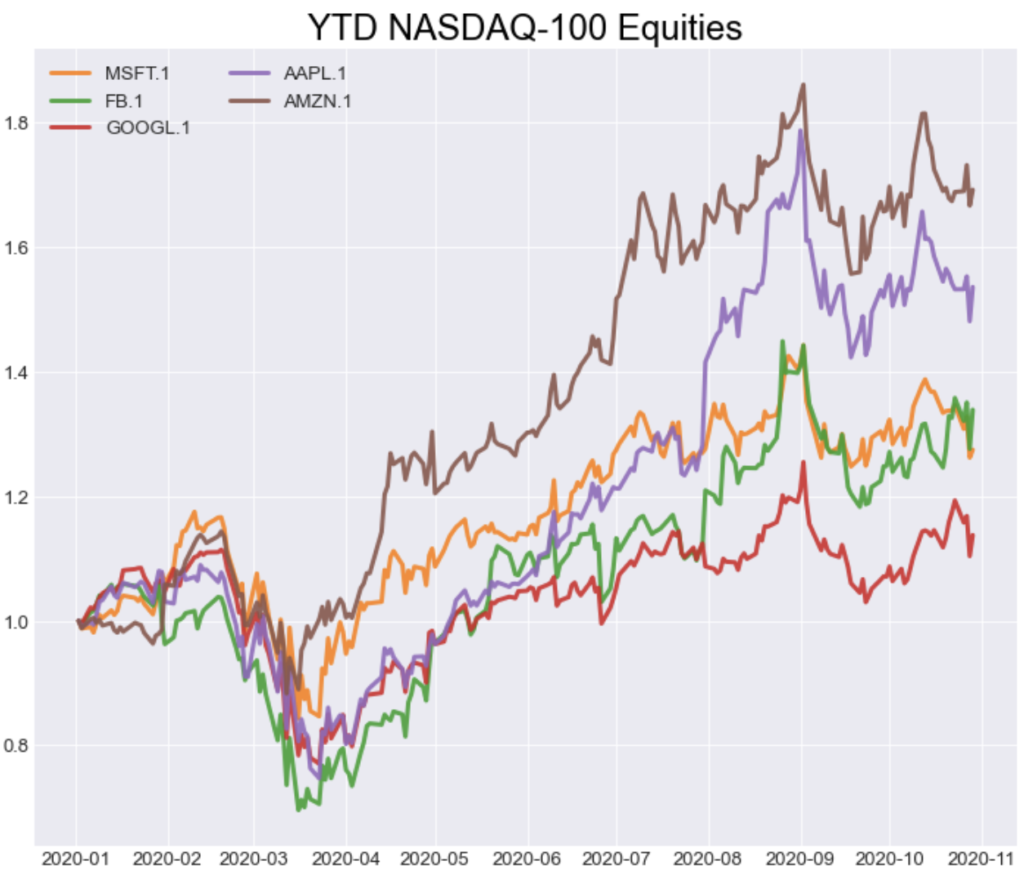
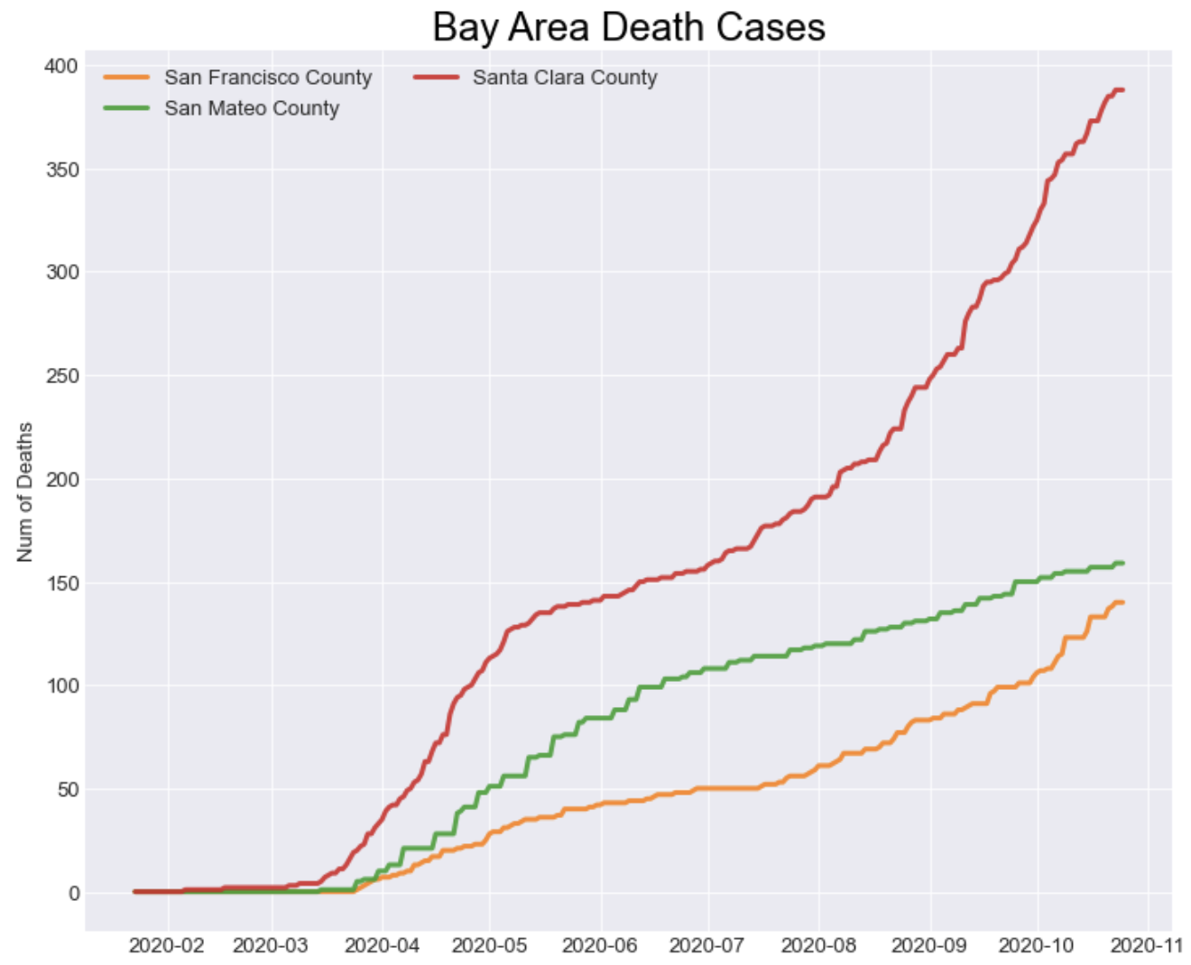
Financial market responded quickly and is barely impacted by Covid-19.
Interest rate decreased to 0% on Mar. 15.
NASDAQ took a hit when Santa Clara county deaths increased exponentially.

Slide 6
How government and people are responding to pandemic
Government Responses
Population Behavior Shift
Case study: College Cases
And how responses may further affect its spread

Slide 7
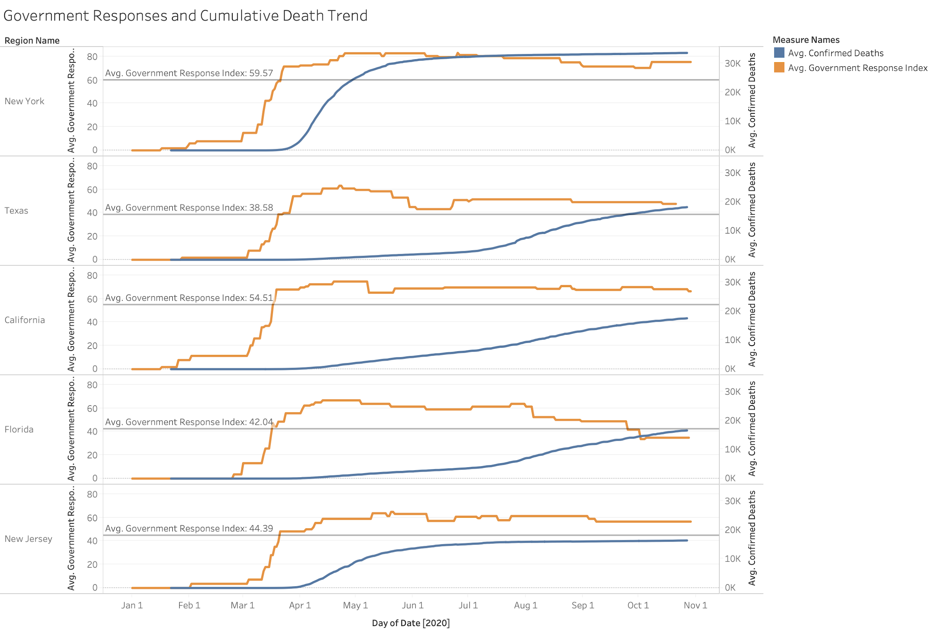
Thomas Hale, Tilbe Atav, Laura Hallas, Beatriz Kira, Toby Phillips, Anna Petherick, and Annalena Pott (2020). Variation in US states’ responses to COVID-19. Blavatnik School of Government.

Slide 8
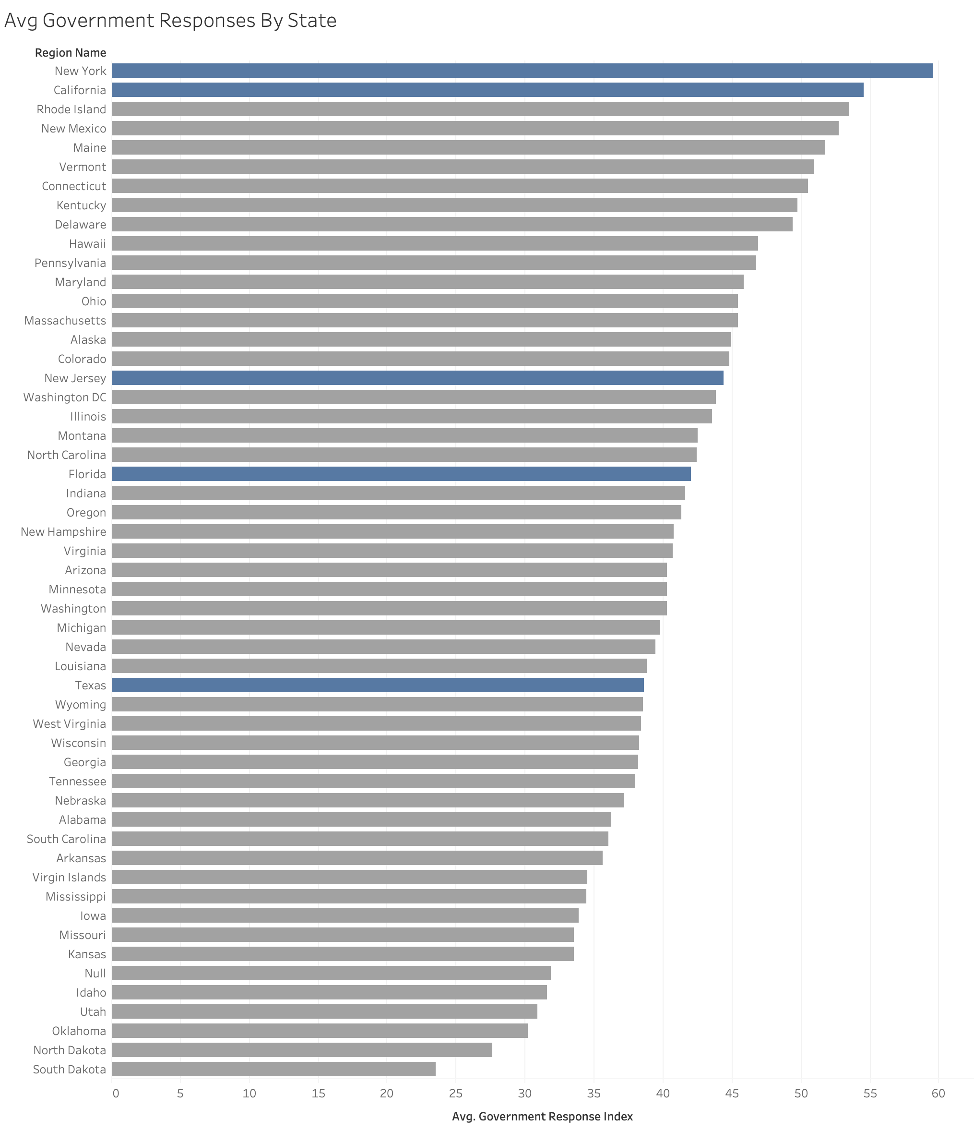
Texas: 33th
Thomas Hale, Tilbe Atav, Laura Hallas, Beatriz Kira, Toby Phillips, Anna Petherick, and Annalena Pott (2020). Variation in US states’ responses to COVID-19. Blavatnik School of Government.

Slide 9
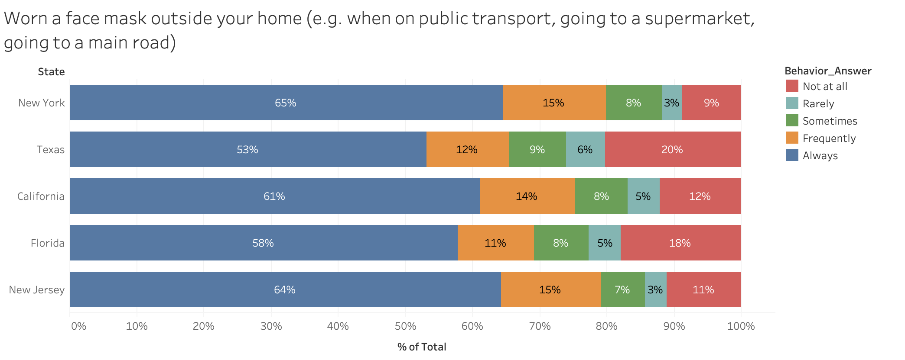
Jones, Sarah P., Imperial College London Big Data Analytical Unit and YouGov Plc. 2020, Imperial College London YouGov Covid Data Hub, v1.0, YouGov Plc, April 2020

Slide 10
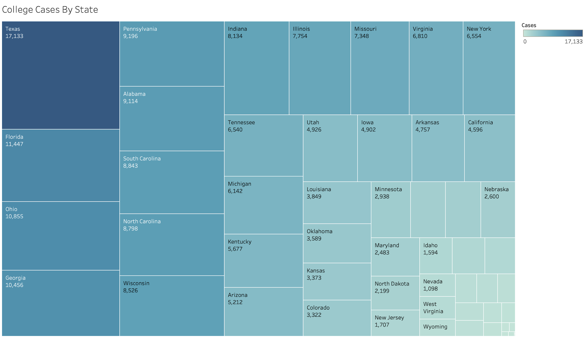
* Data from The New York Times, based on reports from state and local health agencies.

Slide 11
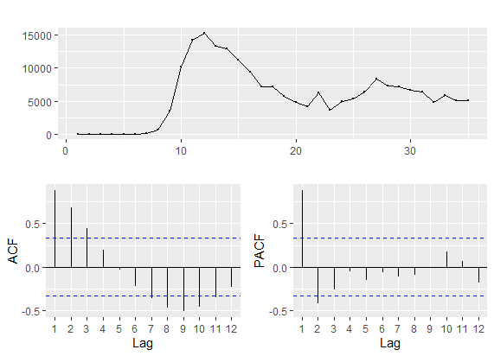
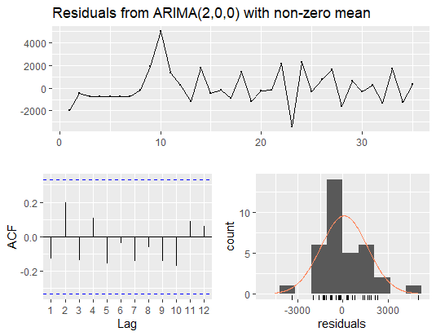
ARIMA - Weekly Observations Nationwide
ARMA(2, 0)

Slide 12
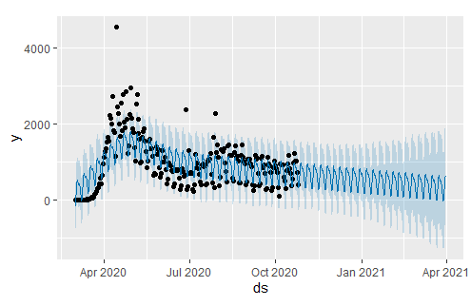
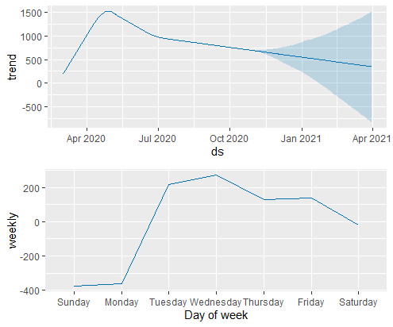
Prophet - Daily COVID-19 Deaths Forecast
The forecast results suggest continuous decrease in daily deaths nationwide till March 2021. The weekly breakdown indicates higher deaths in midweek.

Slide 13

Structural Regression Model and Reasoning
Death i-1: The number of current month death is largely depend on the previous month death count.
Face_Cover_Policy i-2, Retail_Recreation_Mobil i-2: Face covering policy (4 levels) and population-weighted Retail/Recreation Mobility Change two months ago are used because our analysis suggest that it takes about two months to show the effect of policy implementation and behavior change on Covid death cases.
Feb - Oct, 2020. State-fixed effect.

Slide 14
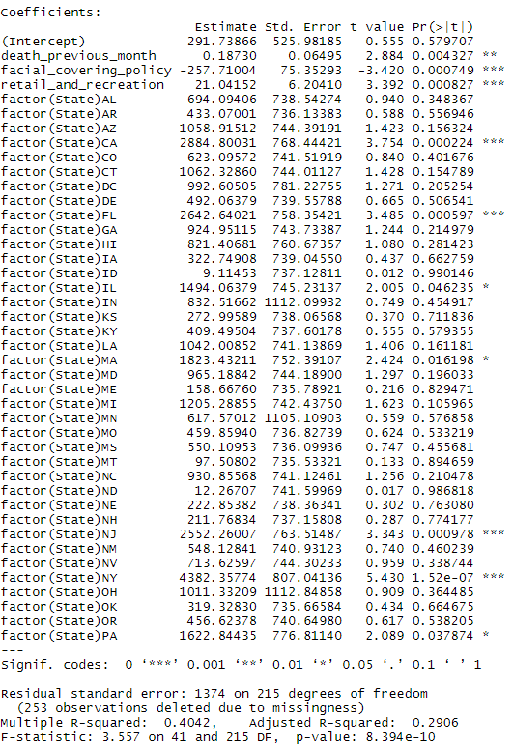
Output & Takeaways
For every 1 more level of face covering policy issued (0-4 levels with 4 being the most strict), it reduces, on average, 257.7 deaths cases in the month after the following month.
For every additional 1 percent mobility reduction in retail and recreation, it reduces 21 new covid deaths in the month after the next month.
Wear Masks and Limit Unnecessary Trips! It saves lives, including your own.

